Slide 1
Introduction to Universal Design
An overview of the concepts in 3 modules

Slide 2
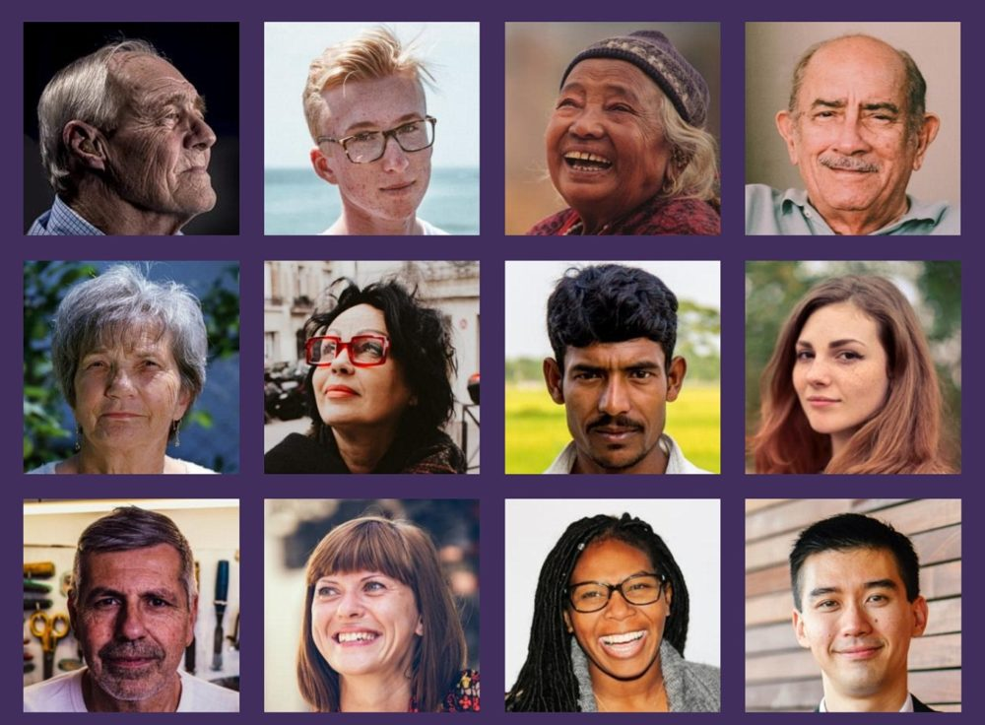
Module 1
In module one you will find out what universal design covers, who it's for, and different definitions of universal design.
This module provides context for the course.

Slide 3
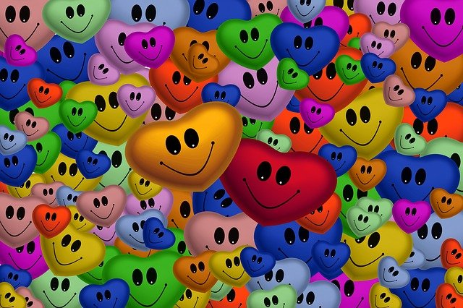
What does it cover?
Universal design concepts apply everywhere for everyone.
It's about creating inclusive places, spaces, products and communications. So universal design covers:
Buildings including homes
Goods, services and products
Urban and open space, parks
Sport, recreation and tourism
Galleries and museums
Communication, websites, phone apps
Transportation
Information services and maps
Policies and plans
Health and education services
Books and publications
Teaching and learning

Slide 4
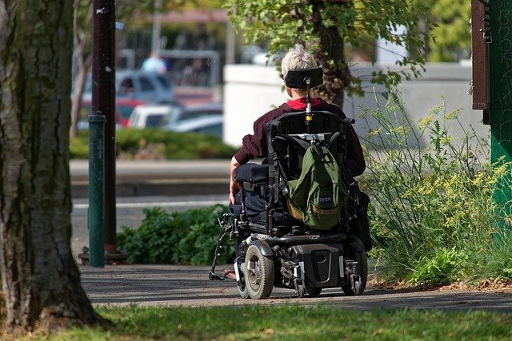
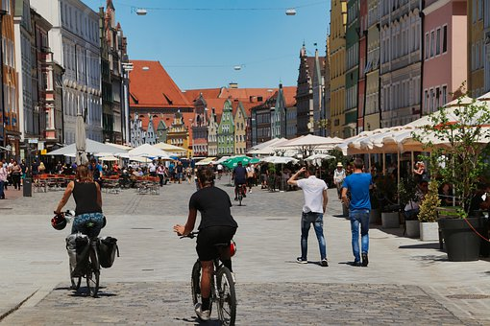
Who does it cover?
Everyone
When universal design was first conceived it was to benefit wheelchair users.
But it was soon realised that accessibility and convenience for people with a mobility disability was also convenient for people without disability.
For example, parents with prams, cyclists and people using delivery trolleys.
These designs were universally good. Hence the term universal design.

Slide 5
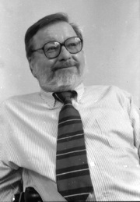
Definitions of universal design
The seven principles of universal design and the most often quoted classic definition were published in 1997.
The definition and principles are attributed to Ron Mace.
However, there were several people involved in developing this definition and the principles.
The classic definition is:
"The design of products and environments to be useable by all people, to the greatest extent possible, without the need for adaptation and specialized design."
North Carolina State University
Ron Mace, Architect
This definition says it is not a special kind of design because it is for everyone.

Slide 6

7 Principles of Universal Design
Briefly, the 7 Principles are:
  Equitable use
  Flexibility in use
  Simple and intuitive to use
  Perceptible information
  Tolerance for error
  Low physical effort
  Size and space for approach and use

Slide 7
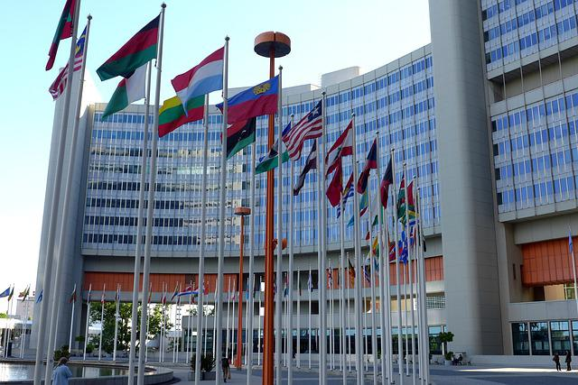
Other terms for universal design
The concepts underpinning universal design are expressed in other terms:
  Inclusive Design is used in the UK.
  Design-for-All is used in Europe.
  Universal Design is used by the United Nations, and many other countries including Australia and the United States.
They all have the same goal - inclusion and equitable treatment.
United Nations Building in New York

Slide 8
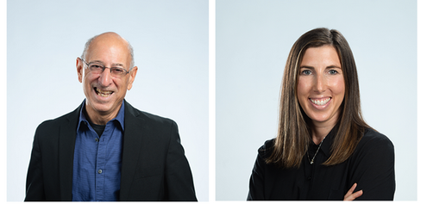
Concepts have evolved
The concepts underpinning universal design have evolved since the 1960s.
Its beginnings were in the built environment, but designers soon realised it could be applied to many other things.
In 2012 the 7 Principles were given a makeover to make them more practical with measurable outcomes.
These became the 8 Goals of Universal Design. They were devised by Ed Steinfeld and Jordana Maisel.
Prof Edward Steinfeld and Dr Jordana Maisel

Slide 9
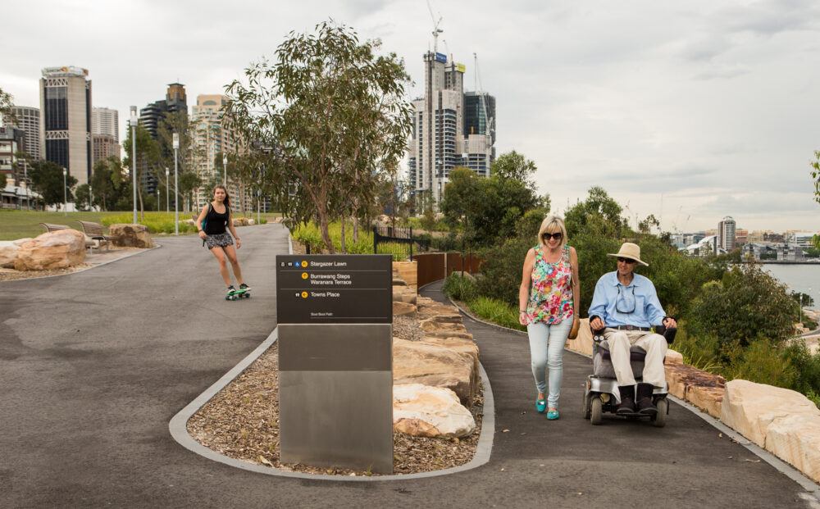
8 Goals of Universal Design
Body Fit: accommodating a wide range of body sizes and abilities
Comfort: keeping demands within desirable limits of body function and perception
Awareness: ensuring that critical information for use is easily perceived
Understanding: making methods of operation and use intuitive, clear and unambiguous
Wellness: contributing to health promotion and protection from hazards
Social Integration: treating all groups with dignity and respect
Personalization: incorporating opportunities for choice and expression of preferences
Cultural Appropriateness: respecting and reinforcing cultural values
Barangaroo Reserve, Sydney, NSW
Photograph by Rick Stevens

Slide 10
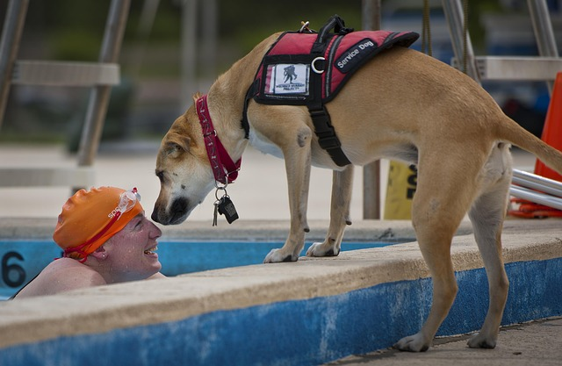
A new definition
"Universal design is a process that enables and empowers a diverse population by improving human performance, health and wellness, and social participation"
Steinfeld & Maisel, 2012
The focus is on people and measurable outcomes rather than building design and designers.

Slide 11
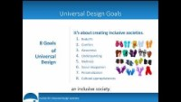
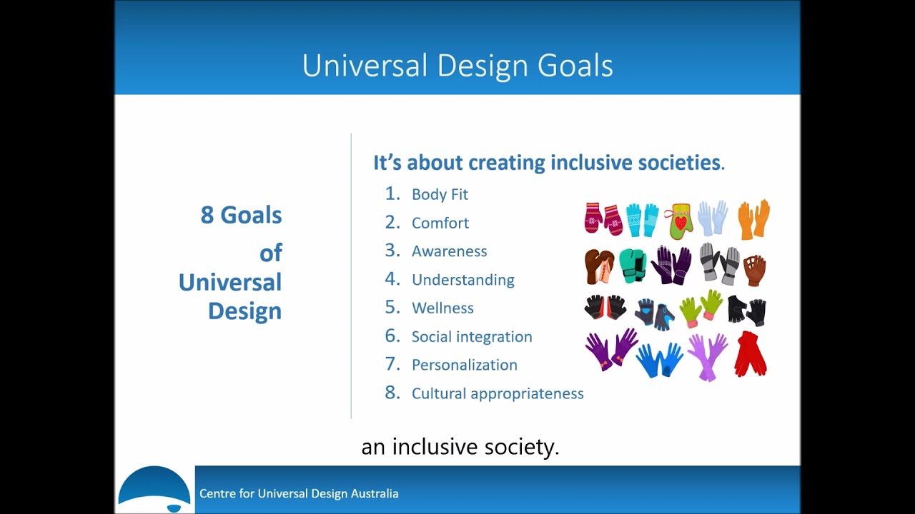
8 goals of universal design – an overview
This video gives an overview of the 8 goals of universal design. This concludes Module One. Complete the short quiz on the next slide to continue to Module Two.

Slide 12

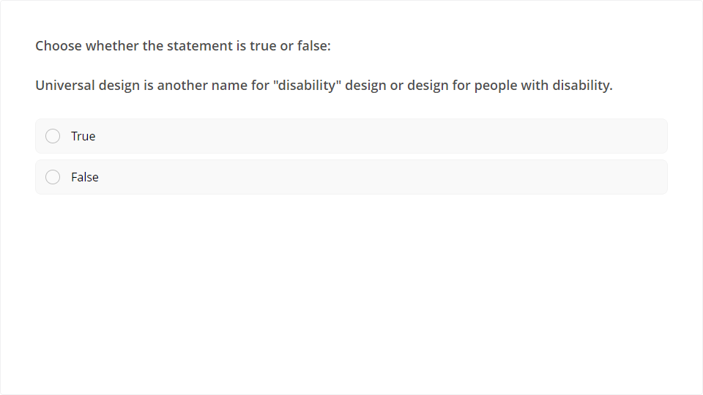
Quiz
Click the Quiz button to edit this object

Slide 13
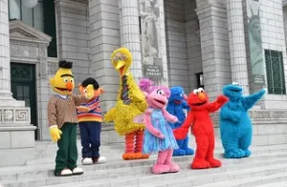
Module 2
Module two discusses diversity and stereotypes and their role in understanding and implementing universal design.

Slide 14
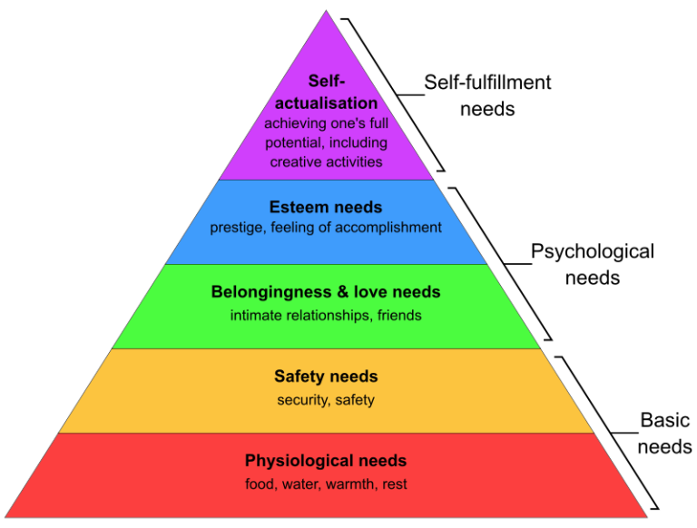
Diversity – same but different
We are all people, but we’re also individuals.
As humans we have the same basic needs.
Maslow explained human needs in a pyramid diagram.
At the base are things like food, shelter and safety.
In the middle are love and belonging.
At the top are esteem and self-actualization – the ability to achieve one’s full potential.

Slide 15
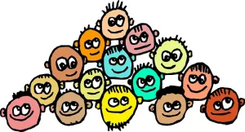
What does diversity mean?
Population
Australia’s population is diverse. There are a lot of data.
The Australian Bureau of Statistics (ABS) regularly surveys the population.
It uses the information to forecast population growth and other demographics. These figures help with planning the future.

Slide 16
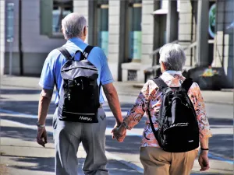
What does diversity mean?
Ageing
We know from statistics that the population is ageing. People are living longer. By 2050 almost a quarter of the population will be over the age of 65 years.
Background
The ABS statistics show that 49 percent of the Australian population was either born overseas or one or both parents were born overseas.

Slide 17
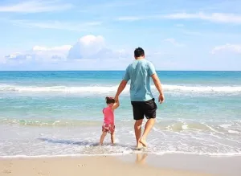
What does diversity mean?
Ability
The number of people with disability has remained stable around 18-19 percent of the population. Almost half of all people with disability are aged over 65 years.
There are many types of disability that prevent people from working, getting an education and being part of social activities.
Disability can be physical, sensory, cognitive, or related to a mental health condition. Some people have more than one disability.
Disability can be temporary, like a broken leg, or it can be permanent, like blindness.
Disability affects family members too, such as going on holiday together or joining a local community event

Slide 18
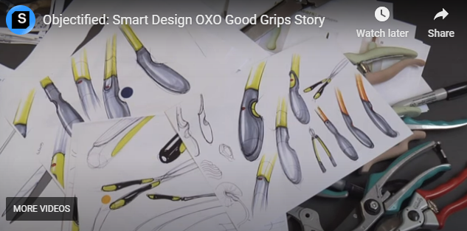
Example: Oxo Good Grips
This video tells the story behind the brand and how designers work to be inclusive.
The company developed the Oxo Good Grips brand in response to population diversity.

Slide 19
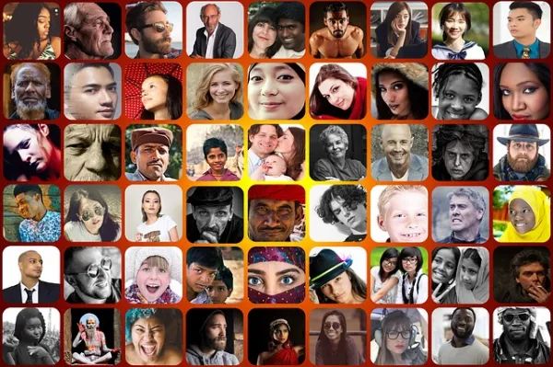
The myth of the “average”
We have different needs and aspirations and come from all walks of life.
We have different abilities and contribute to society in many different ways.
Despite this, we often get drawn into using stereotypes.
So where do “ordinary average” Australians live?

Slide 20
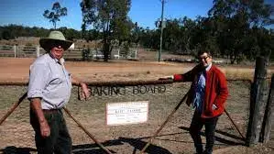
The Average Australian
The highest percentage of average Australians is hanging out in a town called Baking Board in Queensland. The town got its name after a piece of bark was used to mix some damper.
Baking Board is 300 km north-west of Brisbane and has the largest percentage of ‘average’ Australians in its population.
How many ‘true-blue’ Aussies live in Baking Board?
Three.
Two people from Baking Board
Yes, that’s three people out of the 97 who matched at least 10 of the most common demographic characteristics.

Slide 21
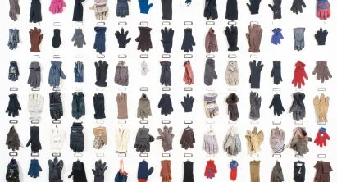
We’re the same but different
Statistics tell us about sub-groups of people, but not about the individuals in those groups.
We are the same people, but we are different individuals – we are diverse.
This is why we need universal design.
Let’s take a closer look at stereotypes after the quiz on the next slide.
These are all gloves but they are all different – just like us!

Slide 22
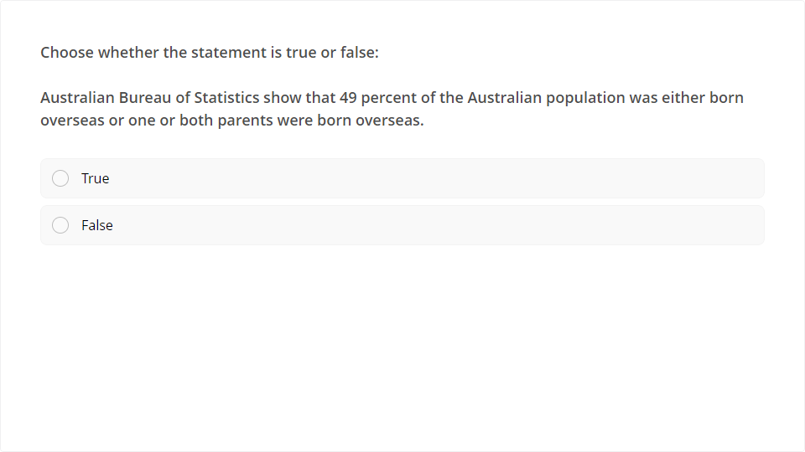
Quiz
Click the Quiz button to edit this object

Slide 23
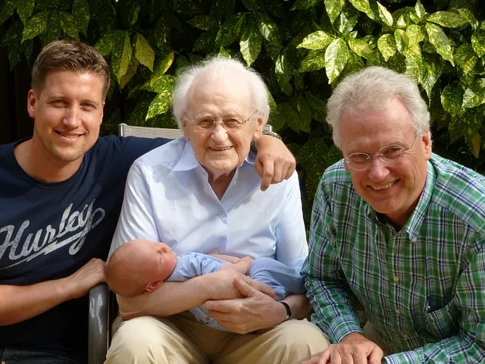
Stereotyping
Statistics are often used to segment the population into particular groups
It’s assumed people in these groups all have something in common or behave in a similar way.
It is also assumed that each group is different from the others and share little in common.
This is stereotyping.

Slide 24
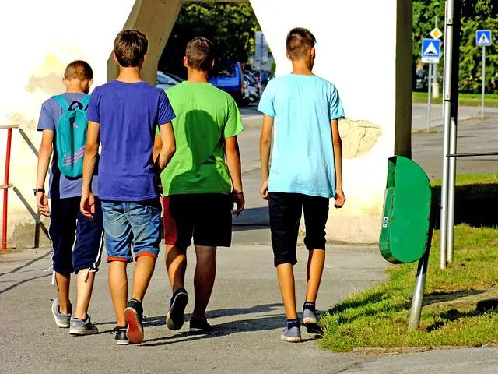
Stereotyping
People can also be stereotyped by race, religion, level of wealth, sexual orientation and intellectual and physical ability.
When we think about all the people in our stereotypical grouping, whether we are, say, a Millennial or Baby Boomer, we know that people in our cohort are individuals.
We are not all the same.

Slide 25
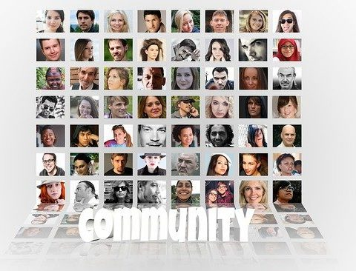
Stereotyping
Stereotyping is often used in negative ways and can lead to prejudice.
It is also part of culture and social perception.
This is why stereotyping behaviour is hard to overcome.
Stereotyping can also apply to images, icons and brands

Slide 26
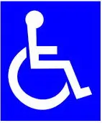
Images, icons and brands
What do you think of when you see the international symbol for access?
Take a moment to think about it.
Then have a look at the video in the next slide.
The video is by Adrian Treharne and is titled, What does this symbol actually mean?

Slide 27
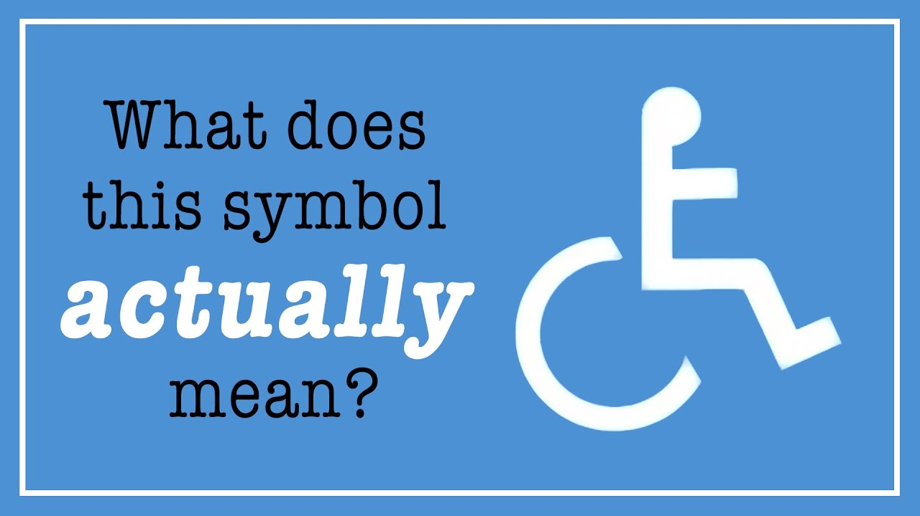
What does this symbol mean?
Did you change your initial thoughts?

Slide 28
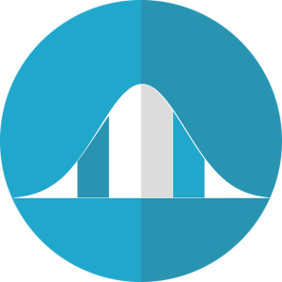
Images, icons and brands can sterotype
The video provides and interesting history of this enduring international icon for disability access.
It also shows how we attach different meanings to brands, icons and images.
These meanings reinforce our stereotypes!
Assumptions, averages and stereotyping restrict design and reduce the size of the potential market.
We need to design for the whole population bell-curve.
A standard statistical bell curve

Slide 29

In Summary…
Universal design is about avoiding stereotypes and embracing diversity:
  - It opens up design thinking
  - Increases the number of users
  Increases the market size
Take the next quiz and then continue to Module 3

Slide 30
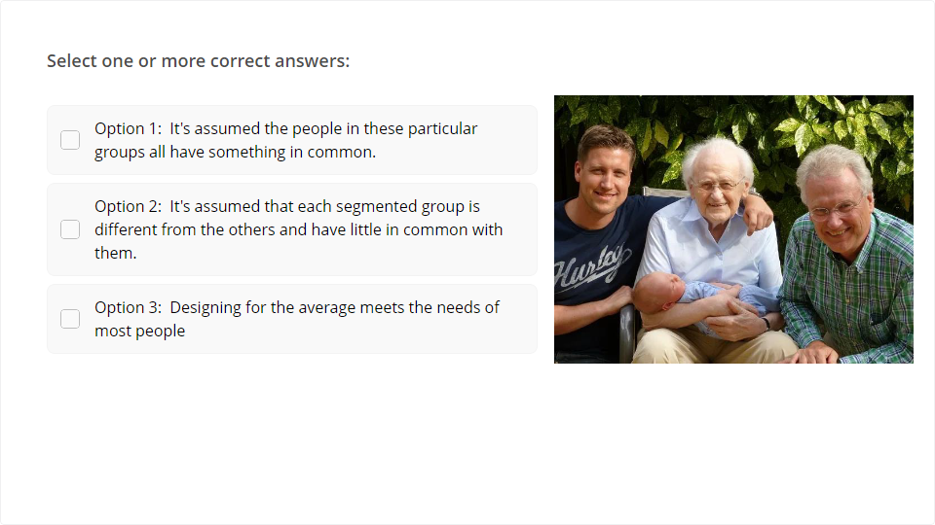
Quiz
Click the Quiz button to edit this object

Slide 31
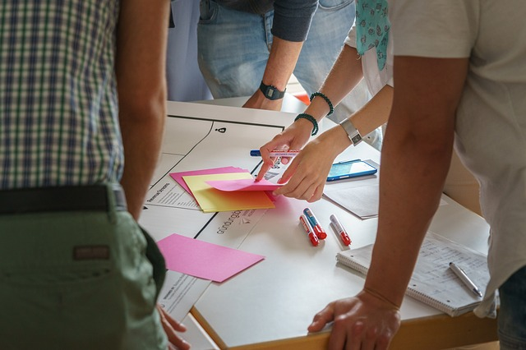
Module 3
This third and final module is about applying universal design.
There is also a summary of the course at the end and the final quiz.

Slide 32
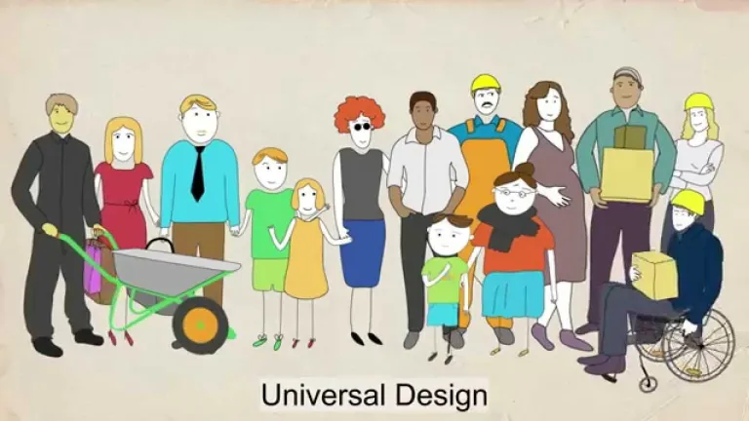
Applying universal design
Universal design is about inclusion and equity. It goes beyond minimum requirements. It requires more thought, not cost. It’s about the users.
Universal design requires thought and care.
It’s about getting it right for as many people as possible.
That’s regardless of age, size, level of capability, gender, education or where users live or lived.

Slide 33

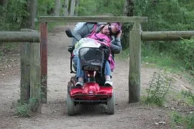
Built environment
Built environment covers all aspects of the public domain including public and private buildings such as:
  Streetscapes
  Open space, parks and playgrounds
  Shops and offices
  Restaurants, cafes, bars
  Transport infrastructure and services
  Sport and recreation venues
  Museums, theatres, galleries
  Places of worship
  Houses, apartments
  Schools, universities
  Tourist attractions
Example of poor signage design
Example of thoughtless design

Slide 34
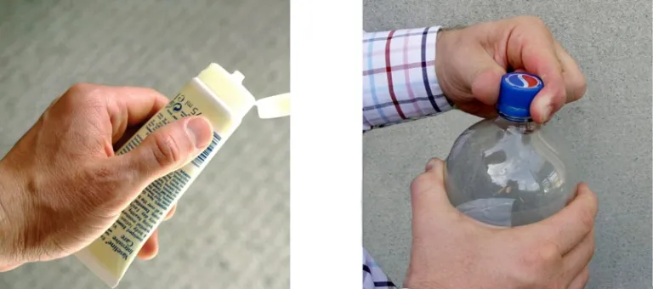
Product design
Product design covers everyday items we use in the home, our workplaces and public places.
  Household items and implements
  Tools and machinery
  Fixtures and fittings
  Furniture
  Street seating, lighting and bins
  Fashion, clothing, footwear, accessories
How many times have you struggled to open or use a product?

Slide 35
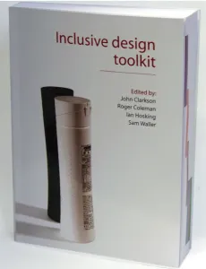
Inclusive Design Toolkit
Check out the Inclusive Design Toolkit from the University of Cambridge.
It provides a good understanding of factors affecting reach and dexterity.
It also has population statistics on how many people have problems grasping and holding things.
You can view an online version of the Toolkit.

Slide 36
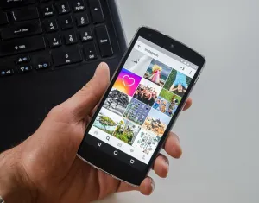
Communications and technology
Smart phones, tablets and computers are everyday products now.
Digital technology is converging on all aspects of our lives.
Major companies like Apple, Microsoft and IBM know that when they design for people who live with disability, they are including other users as well.
In the next slide, the Google video on inclusive design and accessibility provides a good overview.

Slide 37
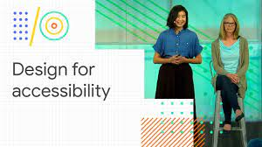
Google goes for inclusion

Slide 38

Universal design and ICT
Check out the short video below – Universal design of ICT – a better digital life. The concepts can be applied to almost all designs. It’s a good summary.

Slide 39
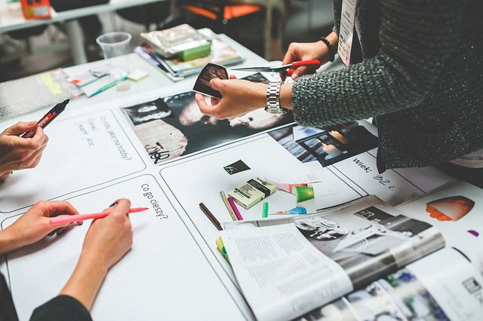
Last words
Universal design:
  Is often in the detail of designs
  Is about the people who use the design
  Requires design thought, not extra cost
The next slide has three minute video with English subtitles.
It nicely explains the 7 principles of universal design to summarise the course.

Slide 40

Summarising universal design
The video summarises the purpose of a universal design approach to design.
https://youtu.be/u7tw-b5Bxy4

Slide 41
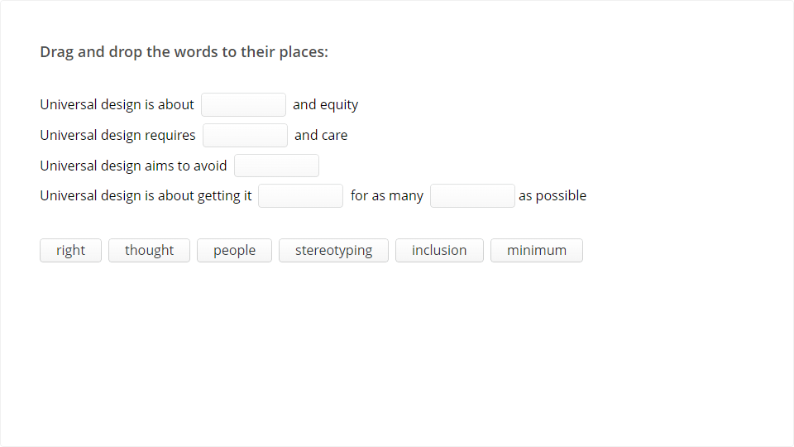
Quiz
Click the Quiz button to edit this object

Slide 42

Congratulations! You’ve completed the course.
We hope you have enjoyed the course. If you have any feedback, please email udaustralia@gmail.com

